Slide 1


A Multi-Sided Business Platform for Plug and Produce Industrial Product Service Systems
Market4.0: Repository connection with M4.0 Services
Vasilis Maratos – LMS
16 December 2020, 15:00 CEST
This project has received funding from the European Union’s Horizon 2020 research and innovation programme under grant agreement no° 822064.
Notes:
(Read the slide)

Slide 2

Content
Overview of Repository connection with Services
Connection Configuration
Equipment Selection Service Connection Use case
AR Service Connection Use case

Slide 3

Market4.0 - Overview of Repository connection with Services
IDS CONNECTION
Equipment Selection Service
Open API Data App
Exec. Core Container
Request data
ESS User
Receive data
Data sovereignty
Prima Database
Prima Data App
Open API Data App
Exec. Core Container
Request data
Receive data

Slide 4
Market4.0 - Connection Configuration
Supplier Repository and Supplier Data Application connection:
  Supplier provide access to Supplier Database (Credentials, Url etc.).
  Description of the architecture of the repository (Ids, Names, Types etc.).
Supplier Data Application and Open API Data App Connection:
  Deployment of Open API existing components with Supplier Data App.
  Use Existing Certificates for Data authentication.
  Provide a Swagger description of Data Application Methods.
https://gitlab.com/market4.0
https://app.swaggerhub.com

Slide 5
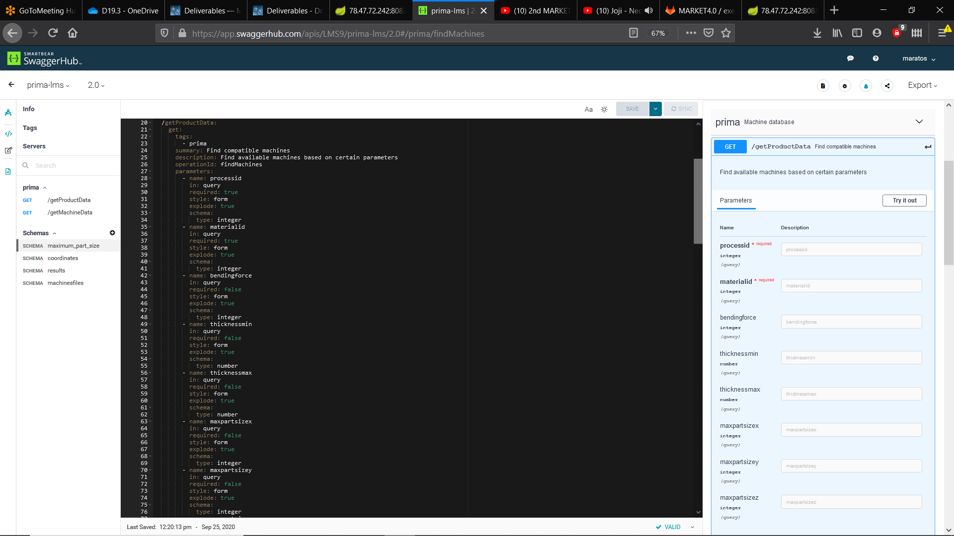
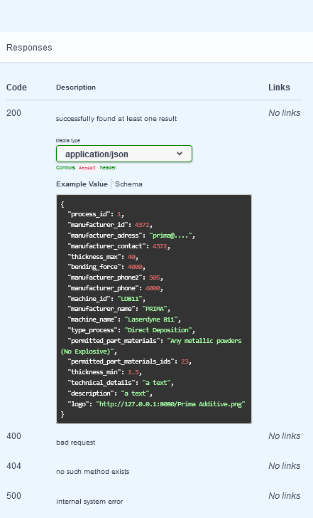
Market4.0 - Connection Configuration

Slide 6
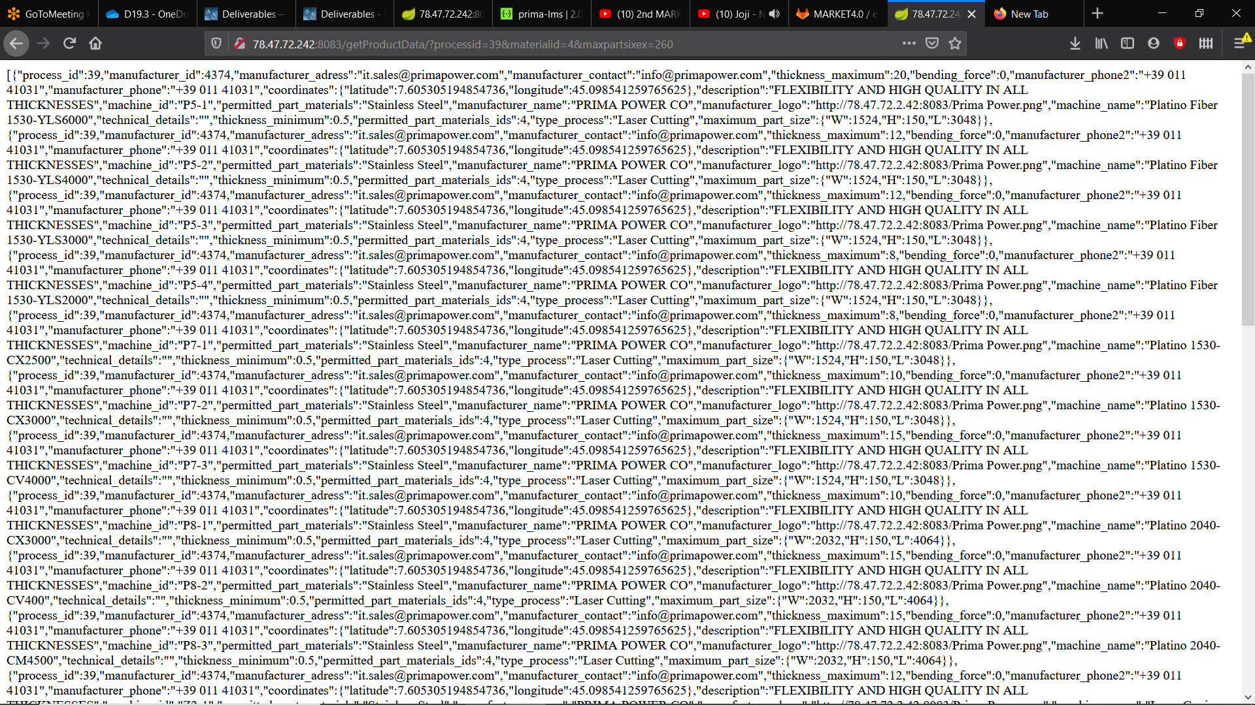
Market4.0 - Equipment Selection Service Connection Use Case
Equipment selection is a service that is used from Equipment selection Data App. Data consumer could select machines through the Prima Database by adjust them to his requirements(process, material, bending force, thickness, dimensions). The results are returned in Json format.
Endpoint | Input | Output | Description
GET /getProductData/?processid=x&materialid=x | Mandatory: processid (Integer)=” “ materialid (Integer) = “ ” Optional: thicknessmin(Double)= “ “ thicknessmax(Double)= “ “ bendingforce(Double)= “ “ maxpartsizex(Integer)= “ “ maxpartsizey(Integer)= “ “ maxpartsizez(Integer)= “ “ | Return the available machines in JSON Object format. | API is used for finding available machines which are compliant with certain user qualifications.

Slide 7
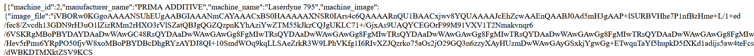
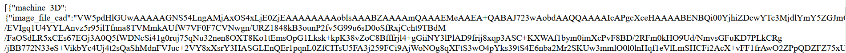
Market4.0 - AR Service Connection Use Case
AR machine visualization is a service that is used from AR App for machine visualization. Inside of the AR App user choose between a gallery of machines CAD files from different manufacturers to visualize and adjust them(translate and rotate) to his manufacturing space.
Endpoint | Input | Output | Description
GET /getMachineData/?machineid=x | Case 1: machineid(Integer)=“NULL” Case 2: machineid(Integer)=“ “ | Return machines 2D and 3D files in JSON Array format. | API is used to import 3D machine files for Visualization.
Case 1:
Case 2:

Slide 8



















THANK YOU
Project Coordinator: INTRASOFT International SA
www.market40.eu
This project has received funding from the European Union’s Horizon 2020 research and innovation programme under grant agreement No 822064
  8

