Slide 1


A Multi-Sided Business Platform for Plug and Produce Industrial Product Service Systems
Market4.0 catalogue generation
Kostas Sipsas – INTRASOFT Intl.
This project has received funding from the European Union’s Horizon 2020 research and innovation programme under grant agreement no° 822064.
Notes:
(Read the slide)

Slide 2
Catalogue generation overview
Prerequisites
Manual generation with our UI (live demo)
Automatic catalogue generation:
Verify
Useful resources

Slide 3
Prerequisites
In order to generate catalogue items you need to:
Register a user
Define the user’s company
We suggest that you use the portal’s interface for these 2.

Slide 4
Manual generation with our UI(live demo)
Note that:
Services and equipment use the same form.
Consider before registering a service if it should be placed in the app store. Key difference:
Apps facilitate purchasing of equipment/services. This includes ordering, equipment identification, visualization, etc.
Production services are production as a service, optimization of production scheduling, consulting, product design, etc. Any service that can sold on its own.

Slide 5
Live demo

Slide 6
Automatic catalogue generation steps
Obtain the authorization token
Generate the catalogue entry
Add image(s)

Slide 7
Step 1: Obtain the authorization token
Essentially this is the login step. The API is:
Endpoint | Input | Output
POST /login | Username and password in JSON. Indicative structure: {"username":"...", "password":"..."} | JSON result: { "data": { "id": "…", "user": { "role": "supplier", "name": "Supplier example", "id": "…" } } }

Slide 8
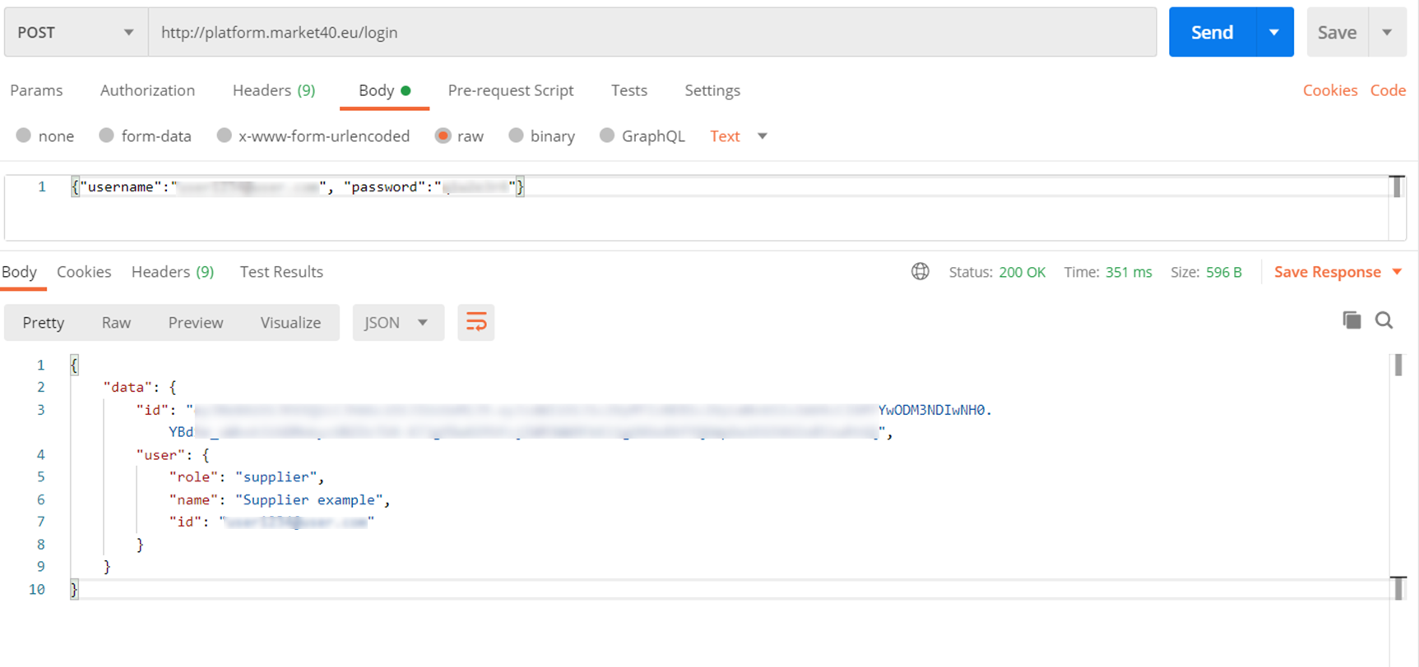
Obtain the authorization token example
The authorization token

Slide 9
Step 2: Generate the catalogue entry overview
The API is:
Endpoint | Input | Output
POST /api/offering/add | Request body in JSON the product description. Example format: { "id": 0, "category": { "id": 0, "name": "string" }, "subcategory": { "id": 0, "name": "string" }, "subcategory2": { "id": 0, "name": "string"}, "name": "string", "description": "string", "secondDescription": "string", "cost": "string", "email": "string", "apps": [{"id": 0, "name": "string"}], "properties": [{"id": 0, "name": "string", "value":"string"}], "url": "string", "orderWith": [{ "id": 0, "name":"string"}], "shipping": true } | Success & product id or failure in JSON format.

Slide 10
Generate the catalogue entry input
id: leave null for new item, use a number to update an item.
category: 1st category level for your item (only id is required).
subcategory: 2nd category level for your item (only id is required, considers level 1).
subcategory2: 3rd category level for your item (only id is required, considers level 2, you can create your own).
name: the name of your item.
description: a brief description of the item.
secondDescription: an additional description of the item.
cost: use 0 for free, or a number representing the price, or “Upon request”.
email: an email to quote the cost (use null if orderWith is filled in).
apps: an array of apps in JSON compatible with the item (only apps ids are required). Excludes ordering apps.
properties: an array of properties relevant to the item (e.g. Condition : New). Only id are relevant you can create your own properties.
url: Leave null for equipment, fill in for services.
orderWith: an array of ordering apps in JSON.
shipping: Set “true” if your item has to be shipped to the customer.

Slide 11
Required headers
For this API the following headers are required:
Authorization: Bearer token_value. Example: “Authorization: Bearer JKGLUFGKF…”
Accept-Language: Alpha-2_country_code. Example: “Accept-Language: DE”
Content-Type: application/json

Slide 12
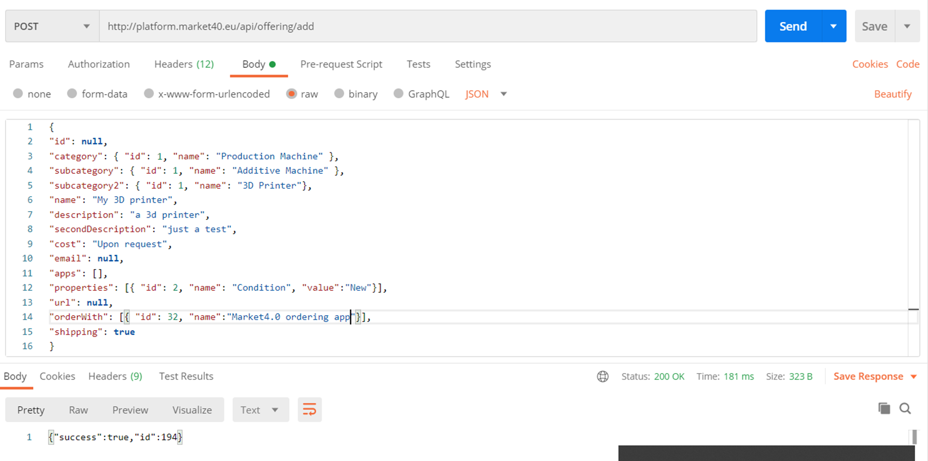
Generate the catalogue entry example

Slide 13
How to get data for categories
The API is (Uses the Accept-Language header):
Endpoint | Input | Output
GET /menu/categories | - | JSON result: [{ "id": 0, "name": "string", "subcategories": [ { "id": 0, "name": "string", "subcategories2": [ { "id": 0, "name": "string" }] }] }]

Slide 14
How to create a third level category
The API is (uses the Authorization and Accept-Language header):
Endpoint | Input | Output
POST /api/subcategory2 | Request parameters: name: item subcategory name id: parent subcategory id | Success or failure in JSON format.

Slide 15
How to get data for apps
The API (uses the Authorization header):
Endpoint | Input | Output
GET /api/apps | - | JSON result: [{ "id": 32, "user": { ... }, "name": “…", "description": “...", "secondDescription": “...", "type": “…", "cost": 0.0, "offerings": [], "allOfferings": [], "images": [{ … }], "url": null, "rating": null, "appBinaries": [], "defaultImage": " …", "appConfig": null, "ordering": true, "installation": “...", "embeddable": true, "intent": null }]

Slide 16
How to get data for properties
The API:
Endpoint | Input | Output
GET /properties | - | JSON result: [ { "id": 0, "name": "string", "value": "string" } ]

Slide 17
How to create properties
The API (uses the Authorization header):
Endpoint | Input | Output
POST /api/property | Parameters: name: name of the property value: value of the property E.g. name: ”Condition” value: “New” | JSON result: { "success": Boolean }

Slide 18
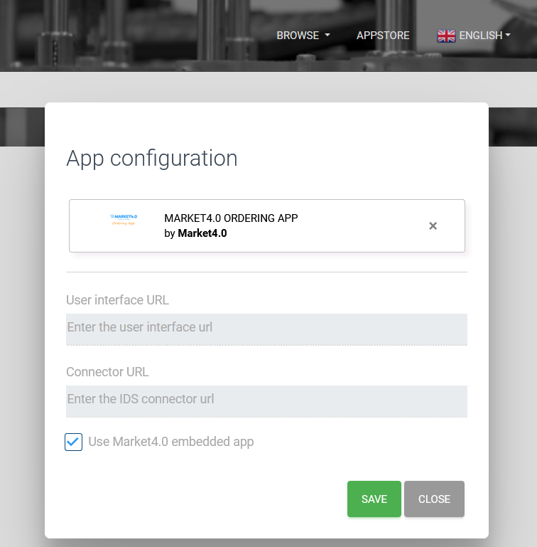
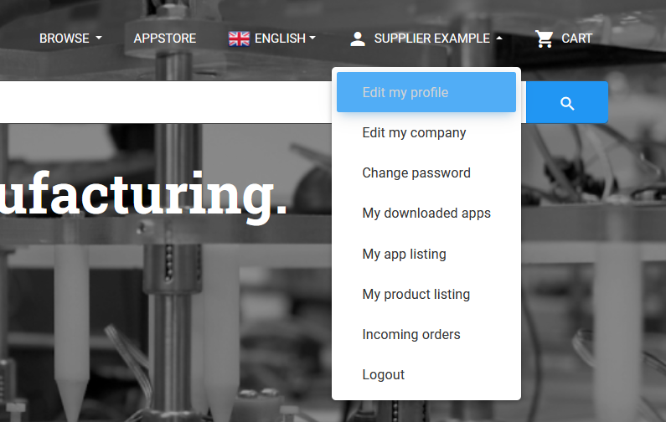
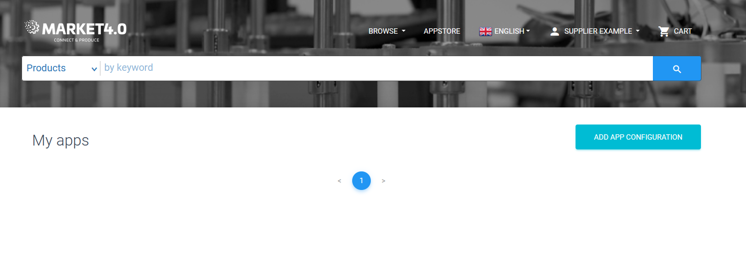
How to get data for ordering apps
The API (uses the Authorization header):
Endpoint | Input | Output
GET apps/ordering | - | Similar output structure to /api/apps API.
Note: In order to get any results in this list you will have to configure ordering apps in your account.

Slide 19
Step 3: Upload image
The API is (Uses the Accept-Language header):
Endpoint | Input | Output
POST /api/offering/add/images | Multipart request. Parameters: Id: offering id Image file | Success or failure in JSON format.

Slide 20
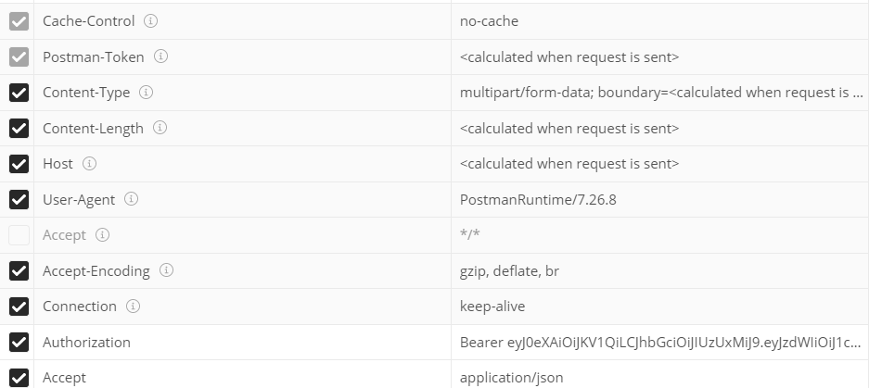
Required headers

Slide 21
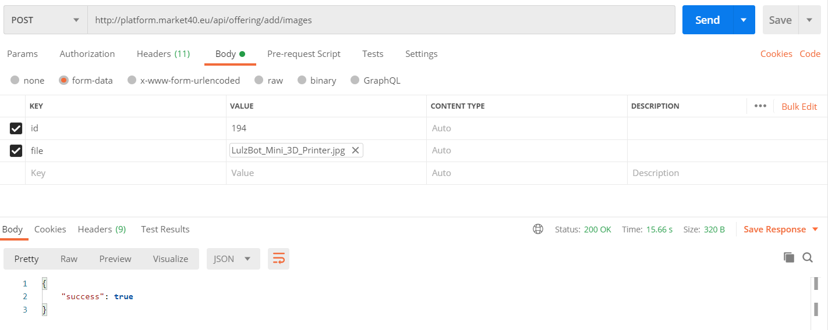
Upload image example

Slide 22
How to set an image a default
The API (uses the Authorization header):
Endpoint | Input | Output
GET /api/image/{id}/offering/{offeringId}/default | Path variables: id: image id offeringId: catalogue item id | JSON result: { "success": Boolean }

Slide 23
How to delete an image
The API (uses the Authorization header):
Endpoint | Input | Output
DELETE /api/image/{id} | Path variables: id: image id | JSON result: { "success": Boolean }

Slide 24
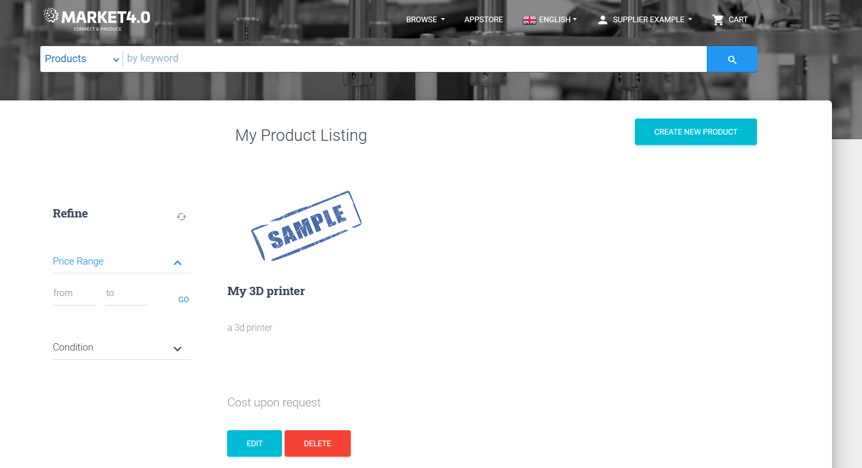
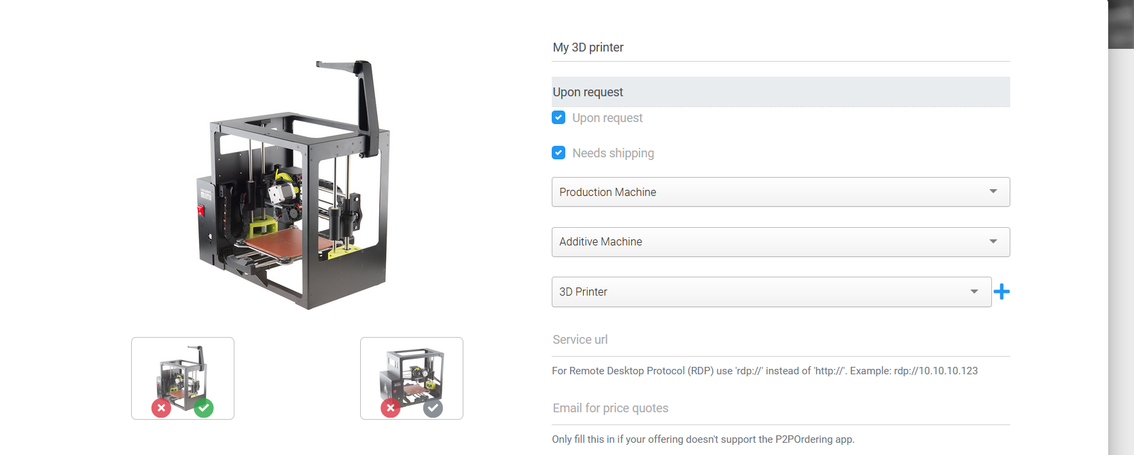
Verification
Step 2
Step 3

Slide 25
Useful resources
Marketplace API:
  http://platform.market40.eu/swagger-ui.html#/
Marketplace user guide: http://platform.market40.eu/guide/MARKET4.0_%20user%20guide_final.docx
Developer guide:
  http://platform.market40.eu/guide/MARKET4.0%20IDS%20reference%20final.docx

Slide 26



















THANK YOU
Project Coordinator: INTRASOFT International SA
www.market40.eu
This project has received funding from the European Union’s Horizon 2020 research and innovation programme under grant agreement No 822064
  26

